Slide 1
Indian sign language to voice
Martin Joseph Juneie
Sandesh Sreeraj P.
Sidharth K.K.
Mentor: Mrs. Haritha H.

Slide 2
contents
Problem Statement
Introduction
Literature Survey
Existing System
Proposed Methodology
Architecture
Advantages
Data Flow Diagrams
Modules
Requirements
Implementation
Conclusion
Future Scope
References
Video

Slide 3
Problem statement
To develop a communication aid for people to understand sign language used by speaking impaired people with ease.

Slide 4
introduction
Communication is the process of exchange of thoughts and messages in various ways such as speech, signals, behavior and visuals.
Deaf and mute people make use of their hands to express different gestures to express their ideas with other people.
Gestures are the nonverbally exchanged messages and these gestures are understood with vision. This nonverbal communication of deaf and mute people is called sign language.
In this project we are focusing on converting Indian Sign Language to speech.

Slide 5
Literature survey
Title | Author | Year | Advantages | Disadvantages | Methodology
American Sign Language to Text and Speech | Vi N.T. Truong Chuan-Kai Yang Quoc-Viet Tran | 2016 IEEE | Precision of 98.7%. Takes live video as input. | Only works on American Sign Language. | Haar for object detection. AdaBoost for feature collection.
Double Handed Indian Sign Language to Speech and Text | Kusurnika Dutta Satheesh Raju K. Anil Kumar G.S. Sunny Swamy B. | 2015 IEEE | Translates double handed sign language. Does not require data gloves. | Lack of precision. | Shi-Tomasi (Minimum Eigen Value) for corner detection. Image processing is performed in MATLAB.

Slide 6
Title | Author | Year | Advantages | Disadvantages | Methodology
Deaf Talk Using 3D Animated Sign Language | Mateen Ahmed Mujtaba Idrees Zain ul Abideen Rafia Mumtaz Sana Khalique | 2016 ACM | 2 way communication 87% precision for speech conversion. 3d simulation. | Does not convert into natural language. | AdaBoost produces an analogous result. Random Forest Regression machine learning algorithm.
Converting sign language to Mandarin-Tibetan cross-lingual emotional speech | Nan Song Hongwu Yang Tingting Zhang | 2018 IEEE | Detection of sign languages and emotions. 90.7% precision for sign. | Does not translate into English. | A deep neural network (DNN)-based framework. Support Vector Machine to classify sign languages.
IEEE Transactions on Neural Networks and Learning Systems | John Doe Jane Smith Mark Johnson | 2018 IEEE | 87% accuracy for converting into sign language . The system can be used in various settings. | Requires a large amount of training data to achieve high accuracy, which can be challenging to collect. | Convolutional Neural Networks (CNN) Recurrent Neural Networks (RNN) Support Vector Machines (SVM)

Slide 7
Title | Author | Year | Advantages | Disadvantages | Methodology
Sign Language to Emotional Speech Conversion by Deep Learning | Weizhe Wang Hongwu Yang | 2021 IEEE | Good gesture and facial expression recognition. | Limited availability of suitable datasets. Low real time performance. | DCGAN for gesture recognition and facial expression recognition. Hybrid LSTM to improve the quality of synthesized emotional speech.
Convolutional Neural Network based Bidirectional Sign Language Translation System | Lance Fernandes Prathamesh Dalvi Akash Junnarkar | 2020 IEEE | Bi directional translation. The accuracy is 99.98 percent as the data-set was made versatile. Several new gestures can be added by training the model with new required datasets. | Incorrect use of various electronic components tend to destroy the whole system. Requires additional hardware. | The flex sensor and accelerometer values on the glove change according to the gesture made.

Slide 8
Existing system
Currently there exists sign language to speech converters only for American Sign Language which is able to only solve a subset of the sign language conversion problem.
Existing systems implements finger spelling translators, however, sign languages are also spoken in a contextual basis where each gesture could represent an object or verb.
Other issues include lack of detection accuracy because of the system not being trained with enough samples.

Slide 9
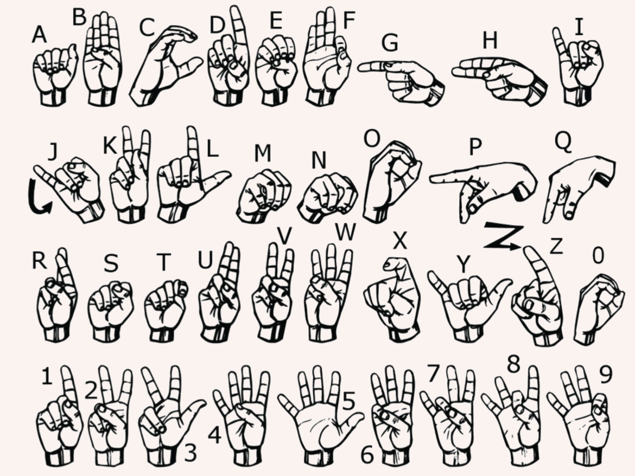
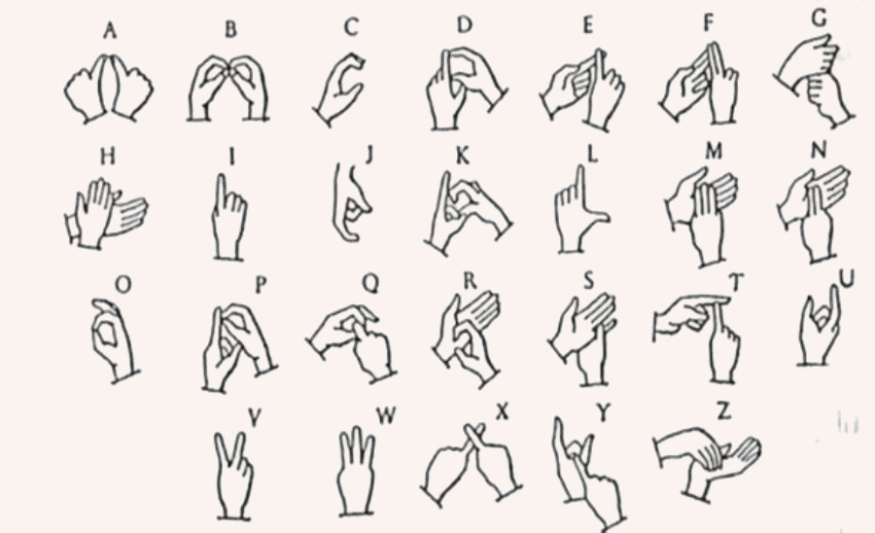
Sign language
American Sign Language
Indian Sign Language

Slide 10
Proposed methodology
dataset
CNN
ui
1
2
3
Creating dataset for training
Building a training model with CNN
User interface - website
Capturing hand images.
Applying hand landmarks.
Defining a region of interest.
Dataset is processed with Teachable Machine to output a trained model.
UI shows the recognised sign as an overlay over the camera feed, at the same time outputting the symbol converted to voice

Slide 11
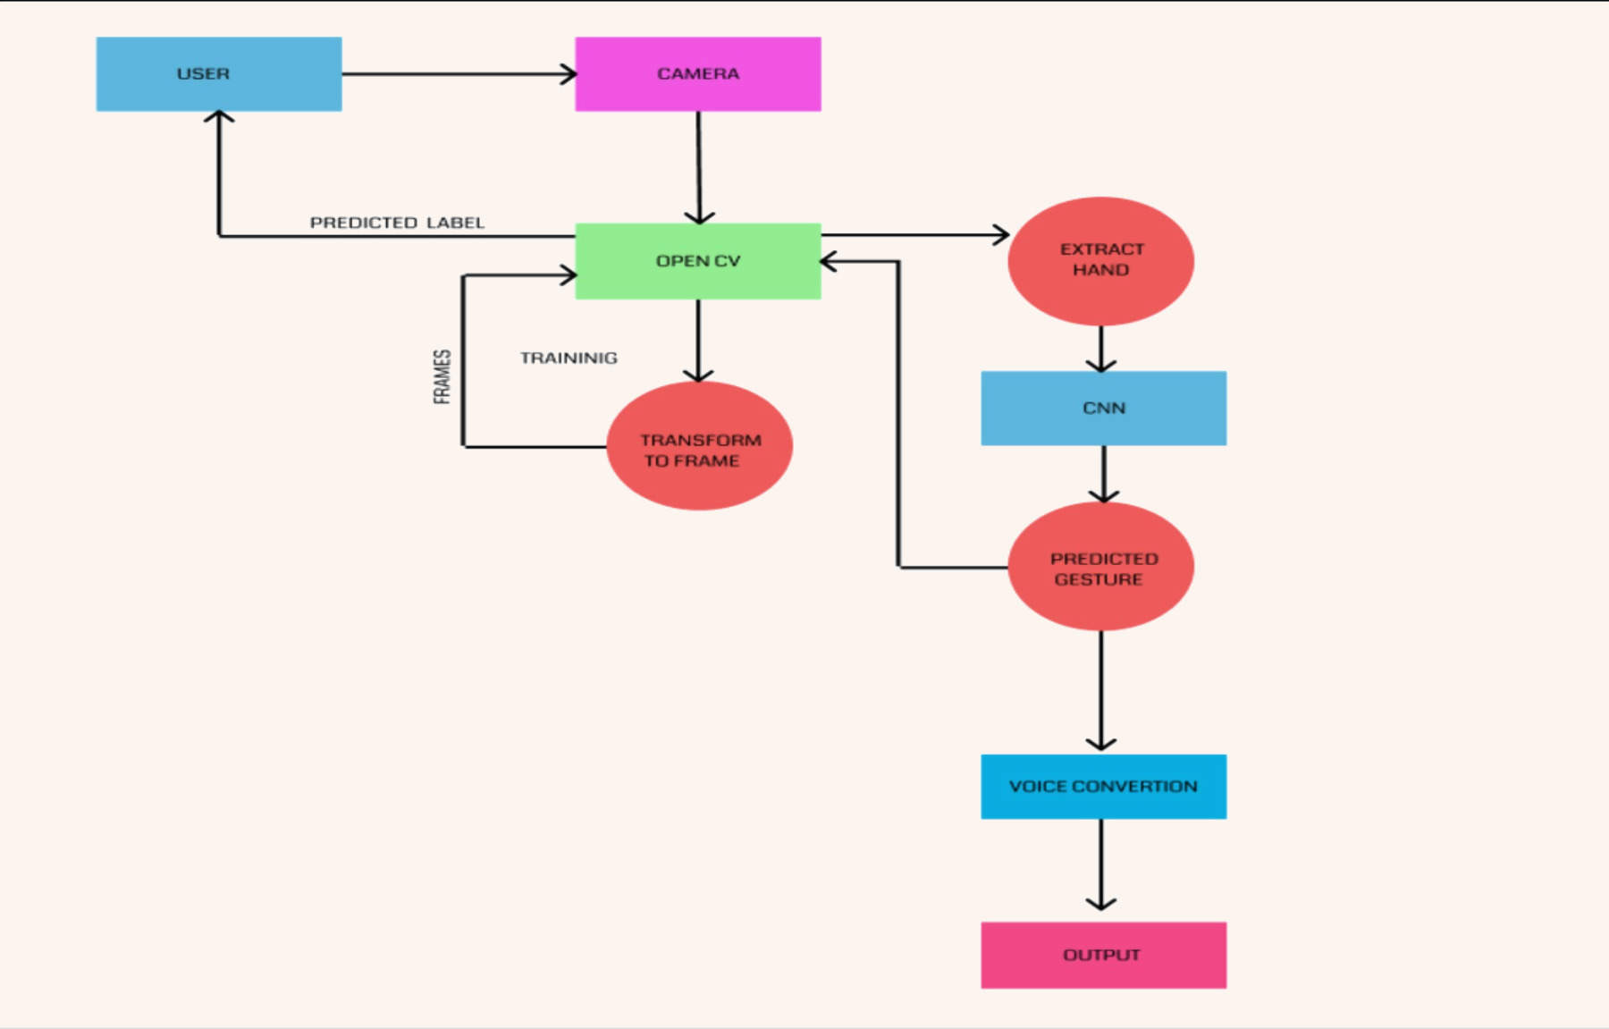
System design or architecture

Slide 12
advantages
Works on Indian Sign Language.
Implements both fingerspelling and gesture based sign recognition.
Accurate recognition because of proper dataset with enough samples.

Slide 13
Data flow diagrams

Slide 14
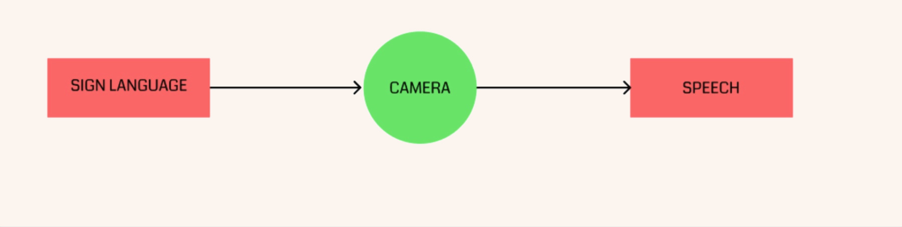
Level 0

Slide 15
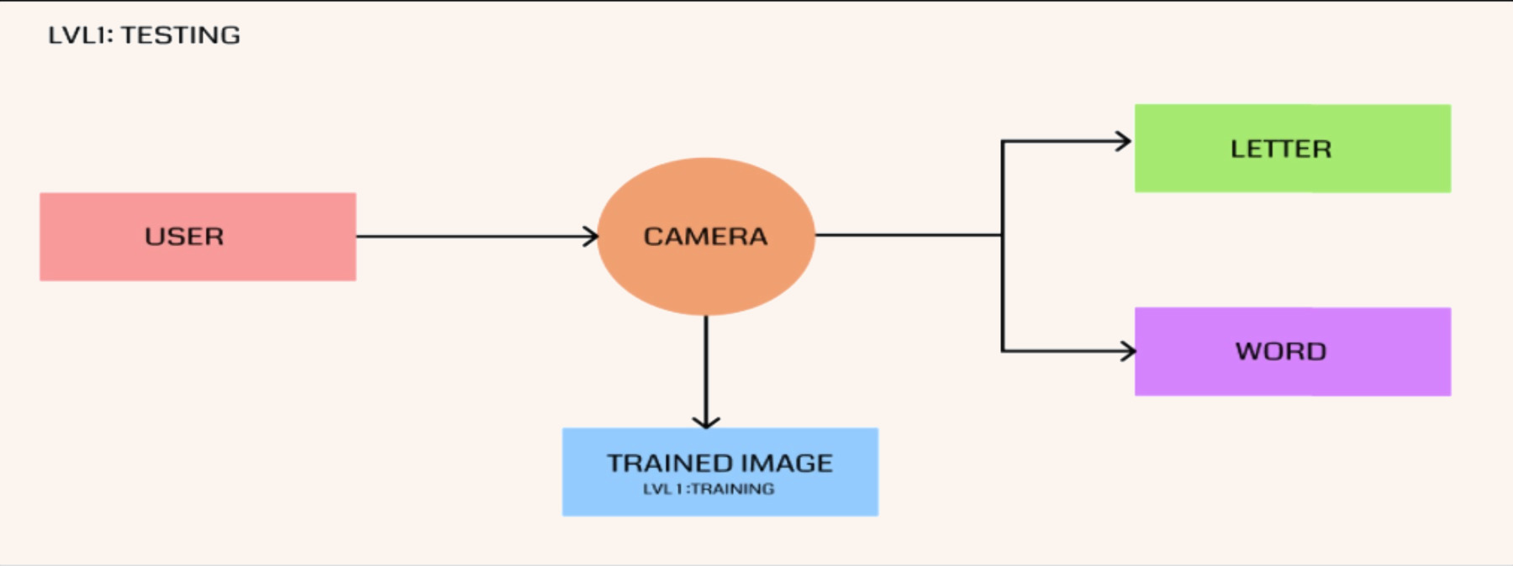
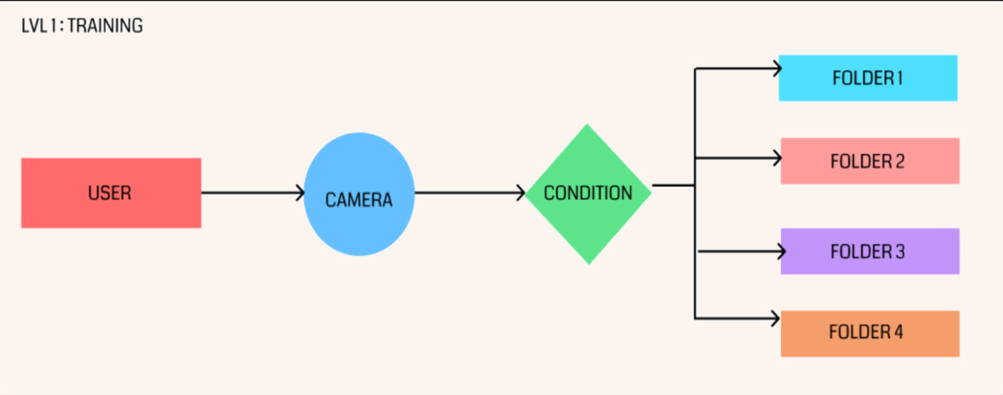
Level 1
Detection
Dataset Generation

Slide 16
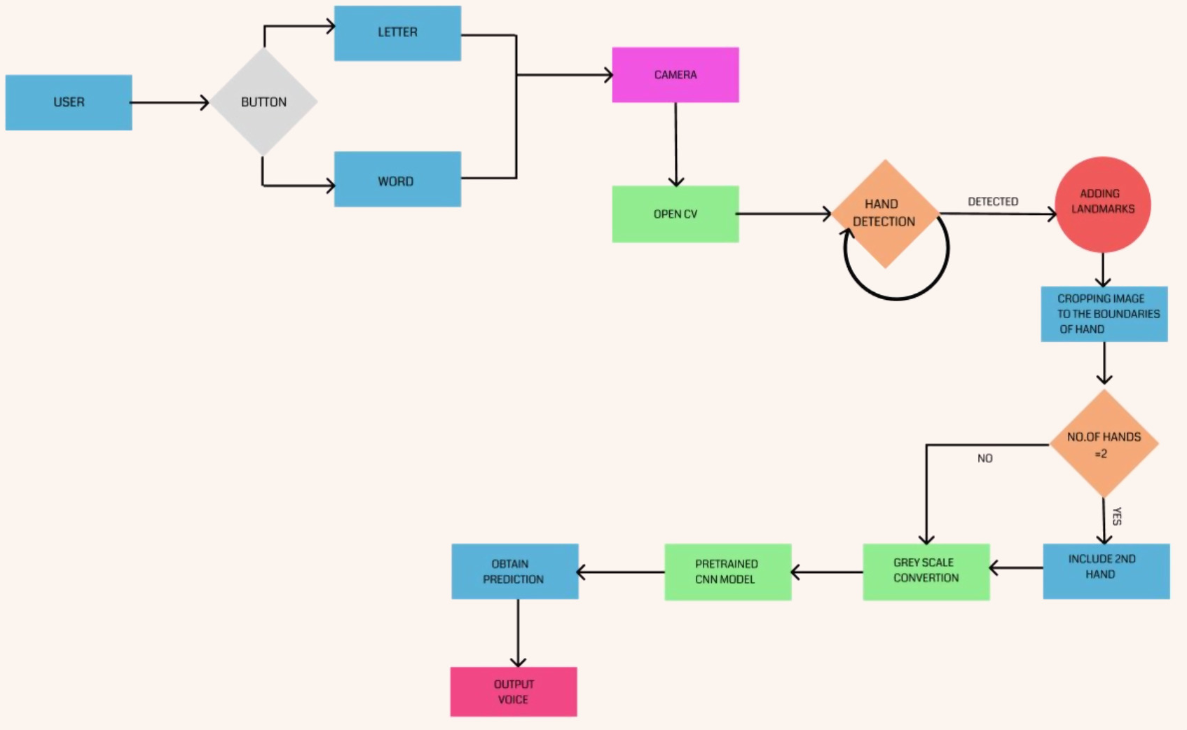
Level 2
onClick()
microservice
VideoCapture()
onClick()
HandDetector()
Image with Landmarks
NO
Cropped Image
Prediction
Grayscale Image
Cropped Image

Slide 17
modules
data set generation
Word
detection
letter
detection
Camera is accessed using OpenCV.
Hand is detected using HandTrackingModule.
Hand landmarks are added.
Image is cropped with respect to the hand boundary.
Image is converted to greyscale.
Frames are captured and saved.
Live feed is obtained using cv2.
Hand is detected using HandTrackingModule.
Hand landmarks are added.
Image is cropped and converted to greyscale.
Frames are run through a pretrained CNN model and prediction is obtained.
Predicted word is displayed as overlay on hand.
The prediction is outputted as audio using pyttsx3.
Live feed is obtained using cv2.
Hand is detected using HandTrackingModule.
Hand landmarks are added.
Image is cropped and converted to greyscale.
Frames are run through a pretrained CNN model and prediction is obtained.
Predicted letter is displayed as overlay on hand.

Slide 18
requirements
HARDWARE REQUIREMENTS
SOFTWARE REQUIREMENTS
The system can run only on computers and not on mobile devices because of the limited processing power of mobile devices, and required packages are not available on mobile platforms.
A camera interface or an image sensor should be available on the host device.
A minimum of 8 GB ram is required for all the computation to be performed.
Python 3.7
OpenCV 4.5.4.60
CVZone 1.5.6
MediaPipe 0.8.10.1
TensorFlow 2.9.1
NumPy 1.21.6
Flask 2.2.5
Pyttsx3 2.90
gTTS 2.3.2

Slide 19
implementation

Slide 20
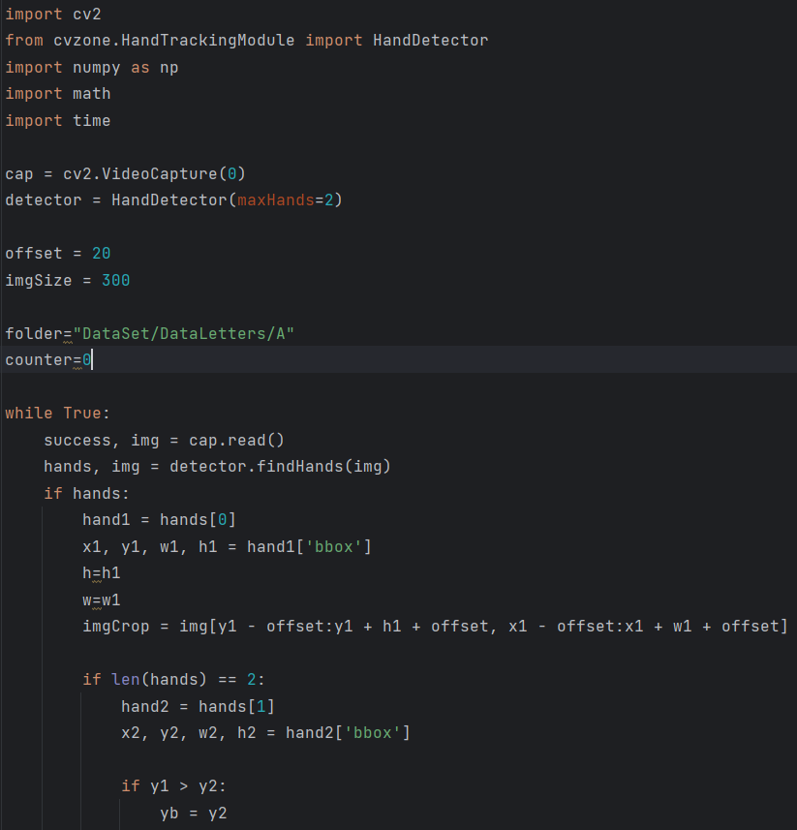
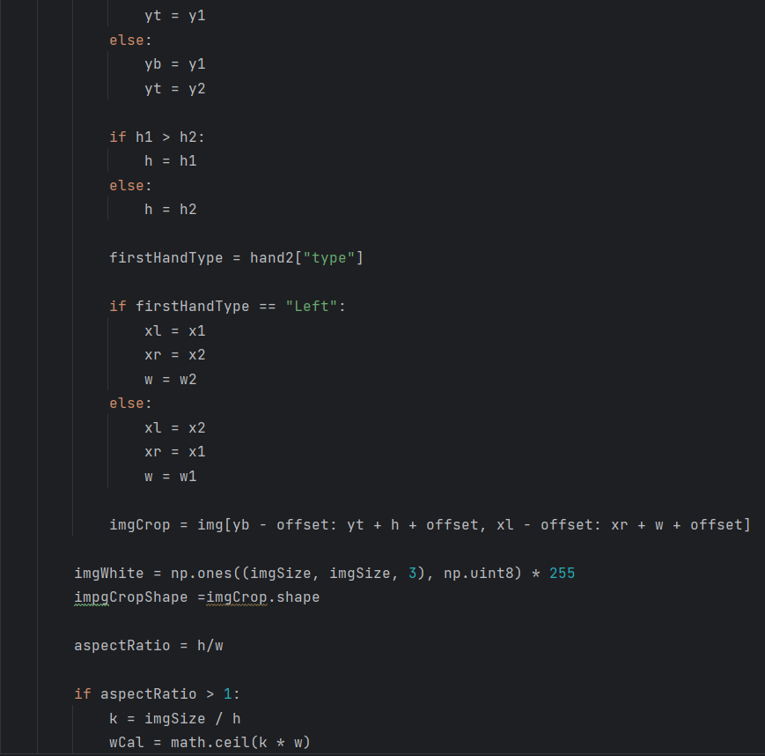

Slide 21
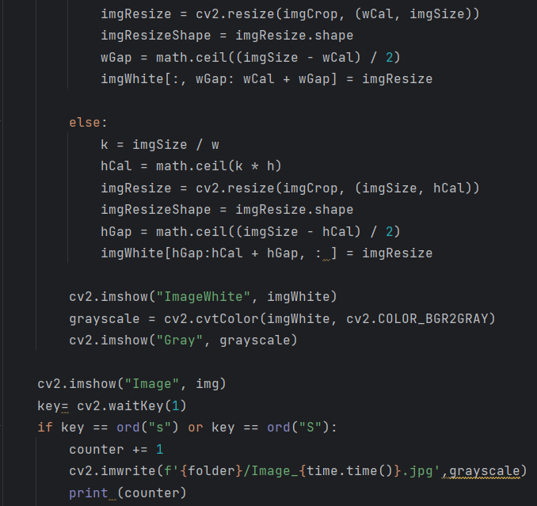
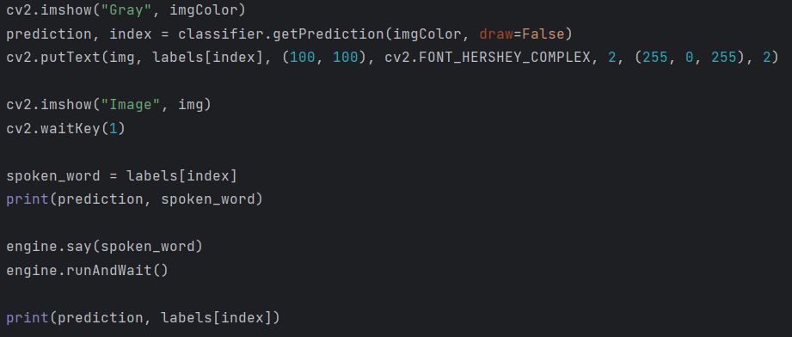
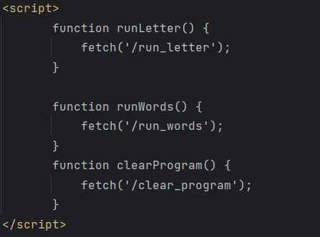

Slide 22
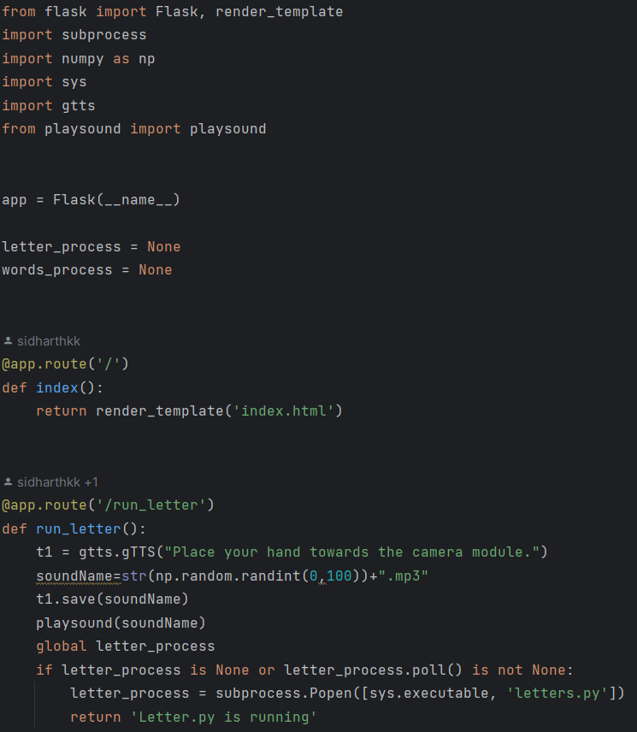
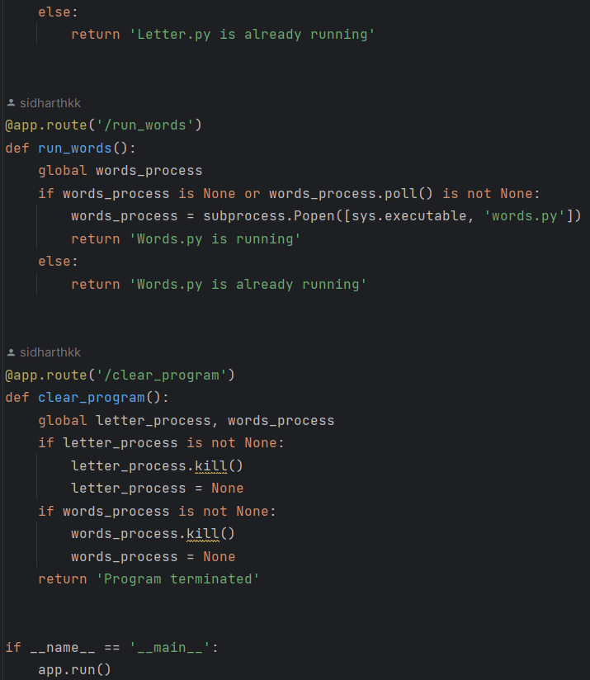

Slide 23
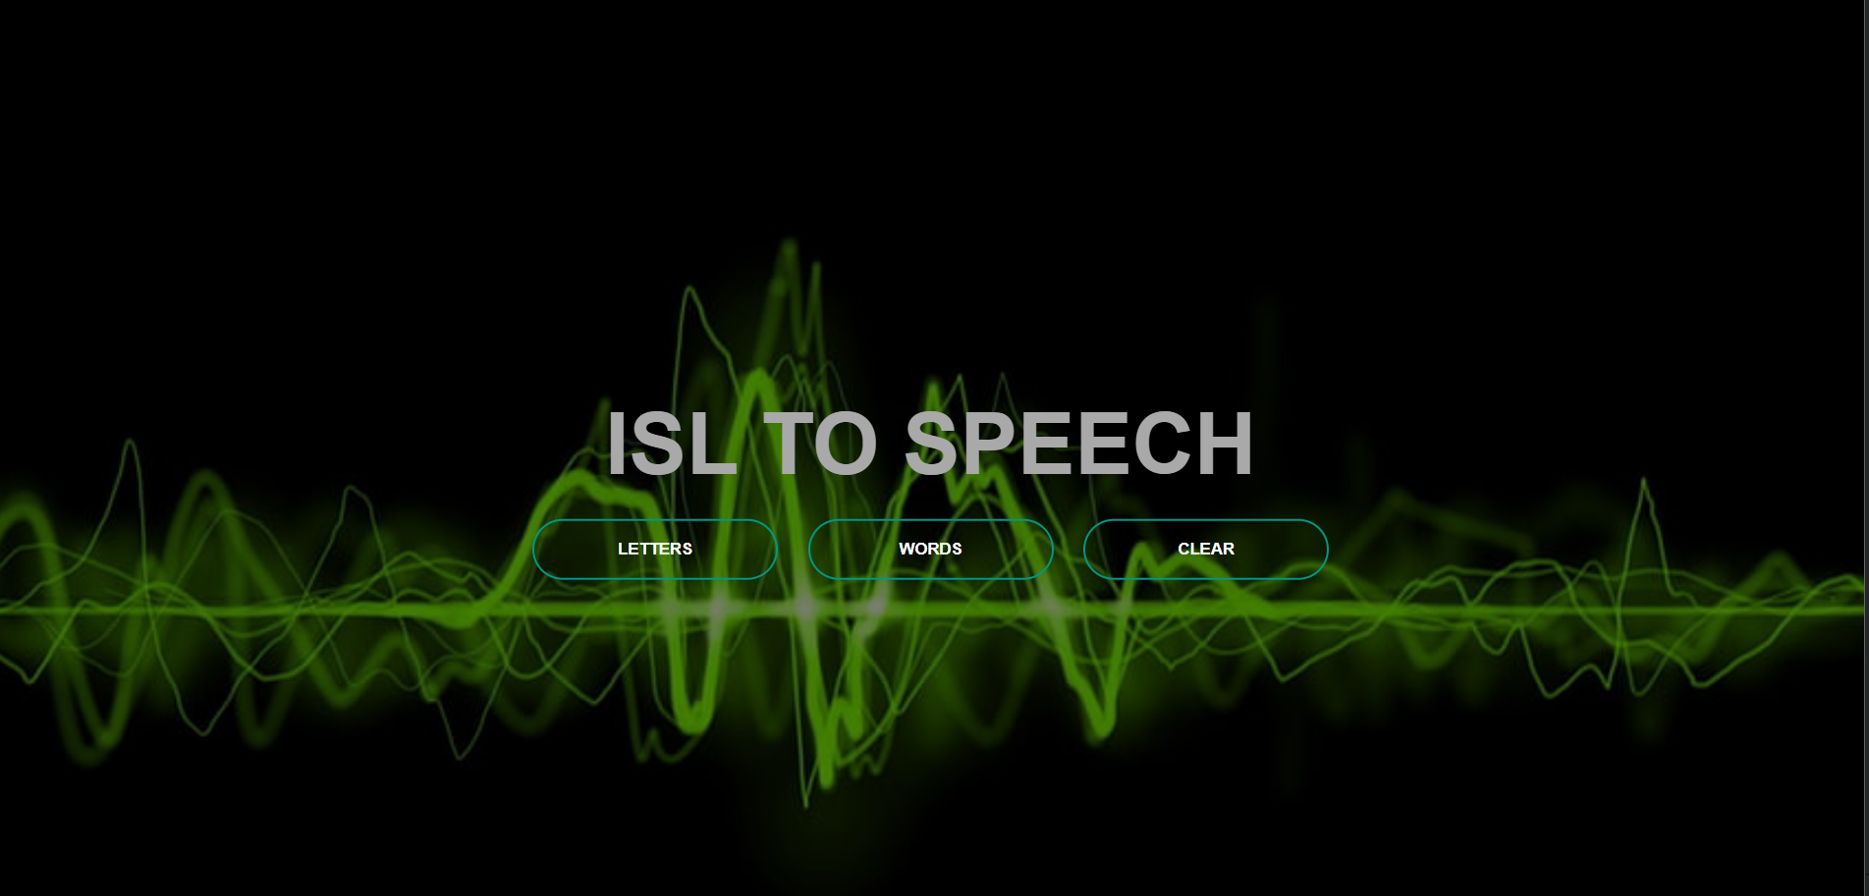
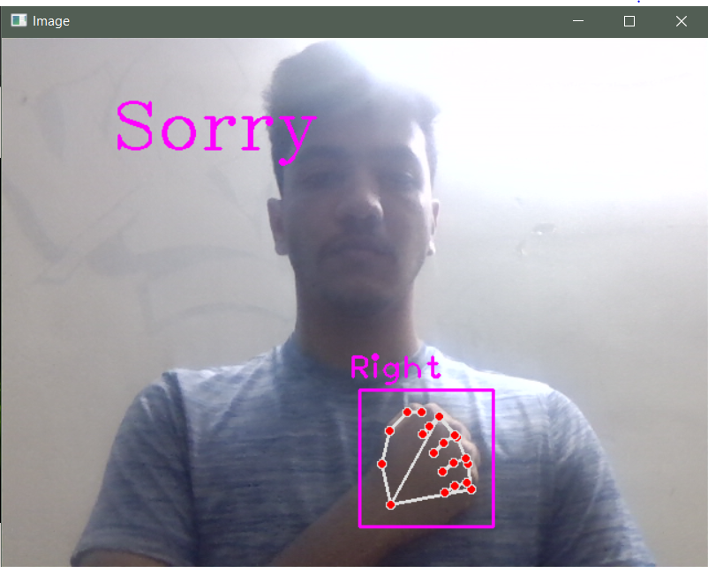
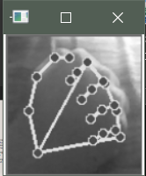

Slide 24
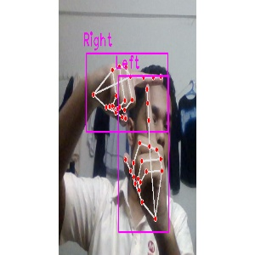
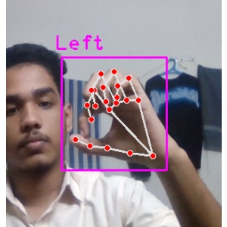
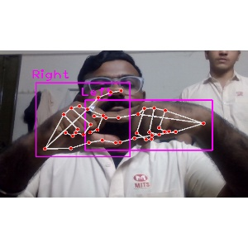
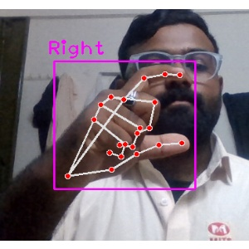
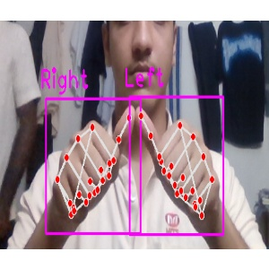
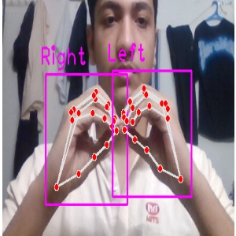
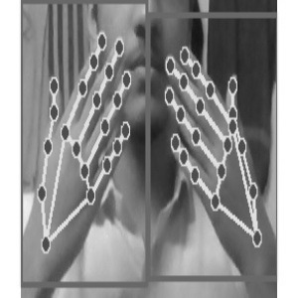
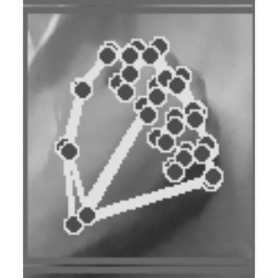
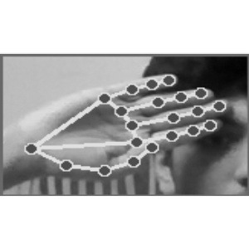
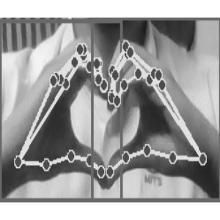
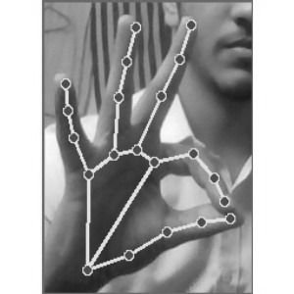
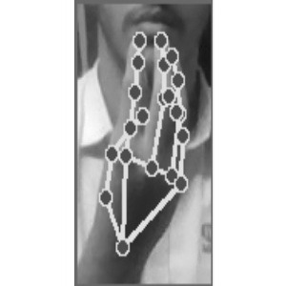
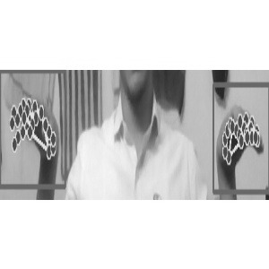
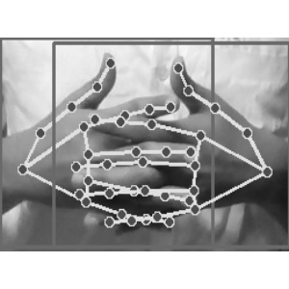
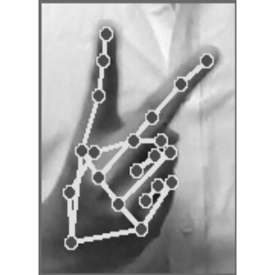
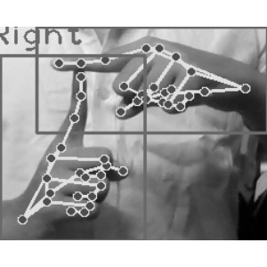
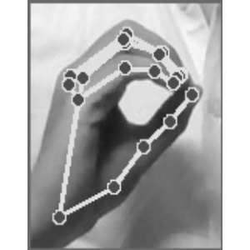
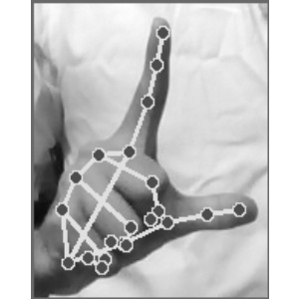

Slide 25
conclusion
In conclusion, the development of an Indian Sign Language (ISL) to voice converter using Convolutional Neural Networks (CNNs) offers a promising solution for enhancing communication accessibility for the hearing-impaired community.
By leveraging the power of CNNs, the system can accurately recognize and interpret sign language gestures.
This technology bridges the gap between sign language and spoken language, providing real-time conversion and facilitating effective communication for individuals who use ISL.

Slide 26
Future scope
The project can be extended to other sign languages by training with the corresponding dataset.
Accuracy can always be improved by using more extensive, diverse dataset.
Mobile applications that integrate the converter would make it more accessible.

Slide 27
references
Truong, Vi NT, Chuan-Kai Yang, and Quoc-Viet Tran. "A translator for American sign language to text and speech." 2016 IEEE 5th Global Conference on Consumer Electronics. IEEE, 2016.
Dutta, Kusumika Krori, and Anil Kumar GS. "Double handed Indian Sign Language to speech and text." 2015 Third International Conference on Image Information Processing (ICIIP). IEEE, 2015.
Ahmed, Mateen, et al. "Deaf talk using 3D animated sign language: A sign language interpreter using Microsoft's kinect v2." 2016 SAI Computing Conference (SAI). IEEE, 2016.
Song, Nan, Hongwu Yang, and Tingting Zhang. "A DNN-Based Framework for Converting Sign Language to Mandarin-Tibetan Cross-Lingual Emotional Speech." 2018 International Conference on Asian Language Processing (IALP). IEEE, 2018.
Song, Nan, Hongwu Yang, and Pengpeng Zhi. "Towards realizing sign language to emotional speech conversion by deep learning." Data Science: 4th International Conference of Pioneering Computer Scientists, Engineers and Educators, ICPCSEE 2018, Zhengzhou, China, September 21-23, 2018, Proceedings, Part II. Springer Singapore, 2018.
Fernandes, Lance, et al. "Convolutional neural network based bidirectional sign language translation system." 2020 Third International Conference on Smart Systems and Inventive Technology (ICSSIT). IEEE, 2020.

Slide 28
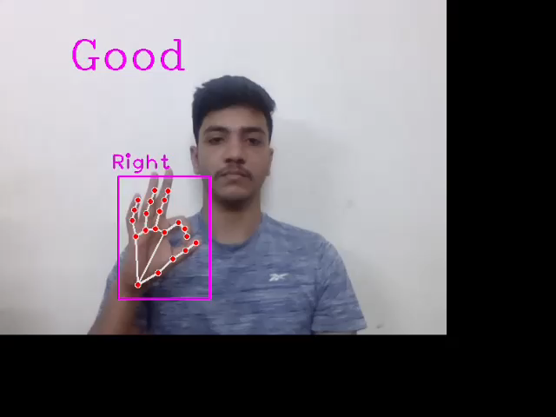

Slide 29
THANK YOU
martinjuneie@gmail.com
sandeshsreeraj@gmail.com
sidharthkeerthanam@gmail.com

